Slide 1
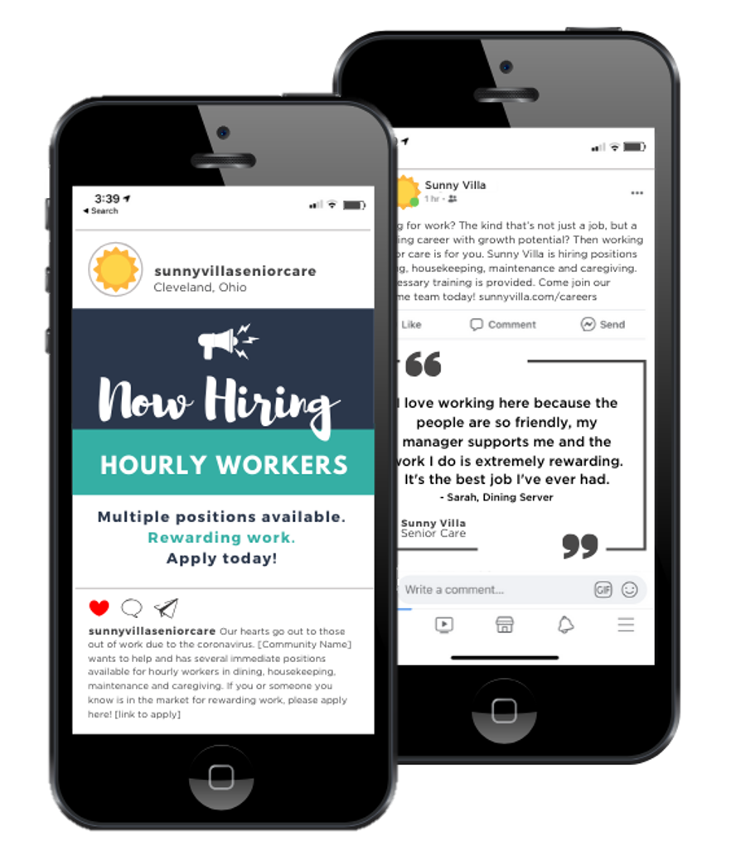
Example Social Posts & Images

Slide 2
Social Post Template Instructions
For the social post copy, fill in the placeholders with your company’s information and then simply copy and paste the post(s) you want to use on your channels. We provide separate posts for Twitter since there is 140-character limit.
For the employee posts, encourage staff to either share your company’s post or create their own post. They can use the language provided in either case.
To use the images, remove the ‘your logo here’ box and then add you own logo in its place. To download the image for use on your channels, simply right click on the image, click ‘save as picture’ and save the image to your preferred folder.
We created separate square images for Instagram since those look best on the platform.

Slide 3
Example Copy For Facebook, LinkedIn & Instagram
Our hearts go out to those recently out of work due to the coronavirus. [Community Name] wants to help and has several immediate positions available for hourly workers in dining, housekeeping, maintenance and caregiving. If you or someone you know is in the market for rewarding work, please apply here! [link to apply]

Slide 4
Example Copy For Facebook, LinkedIn & Instagram
Looking for work? The kind that’s not just a job, but a rewarding career with growth potential? Then working in senior care is for you. [Community name] is hiring positions dining, housekeeping, maintenance and caregiving. All necessary training is provided. Come join our awesome team today! [link to apply]

Slide 5
Example Copy For Facebook, LinkedIn & Instagram
The senior care industry is expected to grow exponentially over the next few years. That means there are plenty of career growth opportunities in this rewarding and necessary field. [Community name] has multiple positions available and provides all necessary training. Interested? Apply today: [link to apply]

Slide 6
Shortened Copy For Twitter
We’re hiring hourly workers! We can offer immediate, rewarding work in areas like dining, housekeeping, maintenance and caregiving. Apply today! [insert link to apply]
Ready to start a rewarding career with growth potential? Then working in senior care is for you. [Community name] is hiring multiple positions for hourly workers. [insert link to apply]
Senior care is a growing industry with tons of rewarding, necessary work. [Community name] is currently seeking hourly workers for multiple positions. Apply today: [insert link to apply]

Slide 7
Example Copy For Corporate-Level Accounts
We at [Organization Name] sincerely feel for those who are now without work due to the COVID-19 pandemic. We would like to let those folks affected know that we are currently hiring for positions closely aligned with retail and hospitality.
We have communities located in [Cities and States] – all of which are taking diligent safety precautions to ensure the well-being of our residents and staff. No experience is required, and we will provide all necessary training.
If you, your friends or your family members are looking for rewarding and necessary work, please visit our careers page and apply. [link to apply]

Slide 8
Example Copy For Employee Posts
To anyone out of work due to the #COVID19 pandemic, my workplace is hiring! [Organization Name] needs workers now for positions closely aligned with retail and hospitality. No experience is required, and all necessary training is provided. Please share this post to help us reach as many people looking for work as possible! Apply here: [link to apply]
If you, your friends or your family members are looking for rewarding and necessary work, my community is hiring! We need people for positions closely aligned with retail and hospitality. Visit our careers page to apply: [link to apply]
Looking for a rewarding career with a great company? Want to come work with me? [Organization Name] is hiring! We need people for positions closely aligned with retail and hospitality. Please hare this post with your friends and family who have been affected by the COVID-19 business closings. Visit our careers page to apply: [link to apply]

Slide 9
Facebook, LinkedIn & Twitter Images

Slide 10
YOUR LOGO HERE

Slide 11
YOUR LOGO HERE
YOUR LOGO HERE

Slide 12
YOUR LOGO HERE

Slide 13
YOUR LOGO HERE

Slide 14
YOUR LOGO HERE

Slide 15
YOUR LOGO HERE

Slide 16
YOUR
LOGO
HERE

Slide 17
YOUR LOGO HERE

Slide 18
Employee Quote Goes Here
- Employee Name, Employee Title Goes Here
YOUR LOGO HERE

Slide 19
Instagram Images

Slide 20
YOUR LOGO HERE

Slide 21
YOUR LOGO HERE

Slide 22
YOUR LOGO HERE

Slide 23
YOUR LOGO HERE

Slide 24
YOUR LOGO HERE

Slide 25
YOUR LOGO HERE

Slide 26
YOUR LOGO
HERE

Slide 27
YOUR LOGO HERE

Slide 28
Employee Quote
Goes Here
Employee Name,
Employee Title Goes Here
YOUR LOGO HERE

Slide 29
#InThisTogether
OnShift is committed to helping senior care providers and employees through the challenging times presented by COVID-19. Every move we make is designed to help providers staff consistently with an exceptional and engaged workforce. We thank you for responding to this new challenge with urgency, diligence and respect to ensure resident safety. Together, we will all come out of this, but you will come out as heroes.

